Slide 1
Single-Cell Analysis of Immune Response to Nanoplastic Particles
Danilo Ristić 2024/3244

Slide 2
Project propositions
Single-Cell Analysis of Immune Response to Nanoplastic Particles Nanoplastics that enter the bloodstream interact directly with immune cells, and particle size appears to shape the response. You will use single-cell RNA sequencing (scRNA-seq) to investigate how nanoplastics of different sizes affect human peripheral blood immune cells
Dataset Description
Source: Zenodo https://zenodo.org/records/15866724 DOI:10.5281/zenodo.15866724
Samples:
Sample 1: 40 nm carboxylated polystyrene nanoparticles (PSNPs)
Sample 2: 200 nm PSNPs
Sample 3: 40 nm + 200 nm mixture
Sample 4: Control (no exposure)
Analysis Workflow
QC & preprocessing — filter cells, normalise, select variable genes. Justify thresholds.
Integration & clustering - combine all four samples with a batch-correction method of your choice; compute UMAP and clusters.
Cell type annotation - assign immune cell types (T, B, NK, monocytes, etc.) using marker genes and the Azimuth PBMC reference (RDS) dataset.
Composition analysis - compare cell type proportions across the four samples.
Differential expression - for each major cell type, compare each exposed sample against the control; run pathway enrichment (GO/Reactome/KEGG).
Size-specific effects - identify responses that are unique to 40 nm, unique to 200 nm, shared, or emerge only in the mixture. Interpret biologically

Slide 3
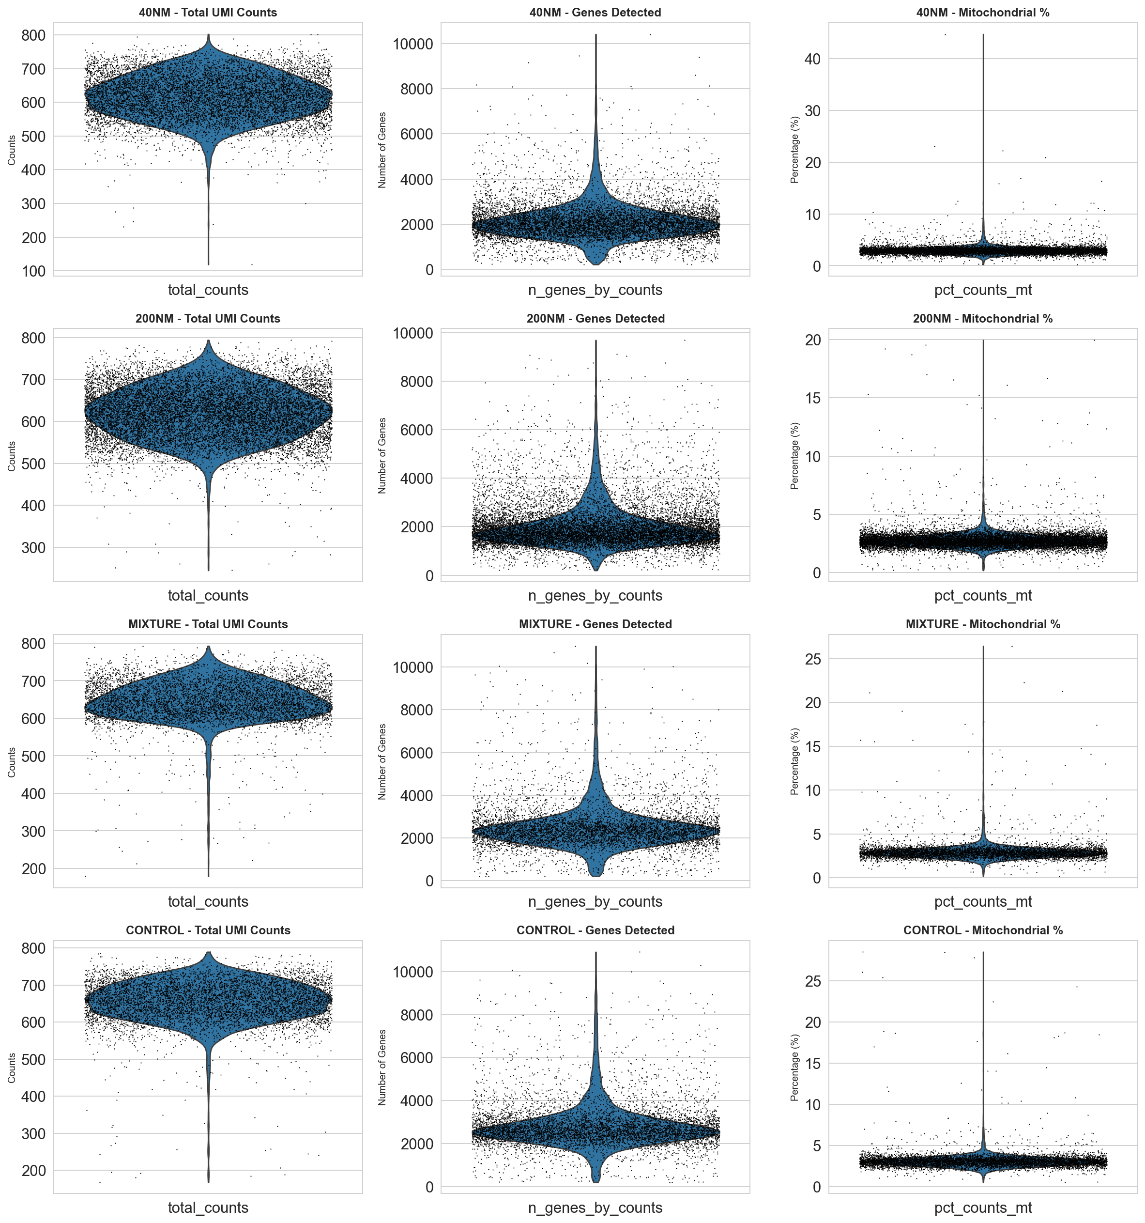
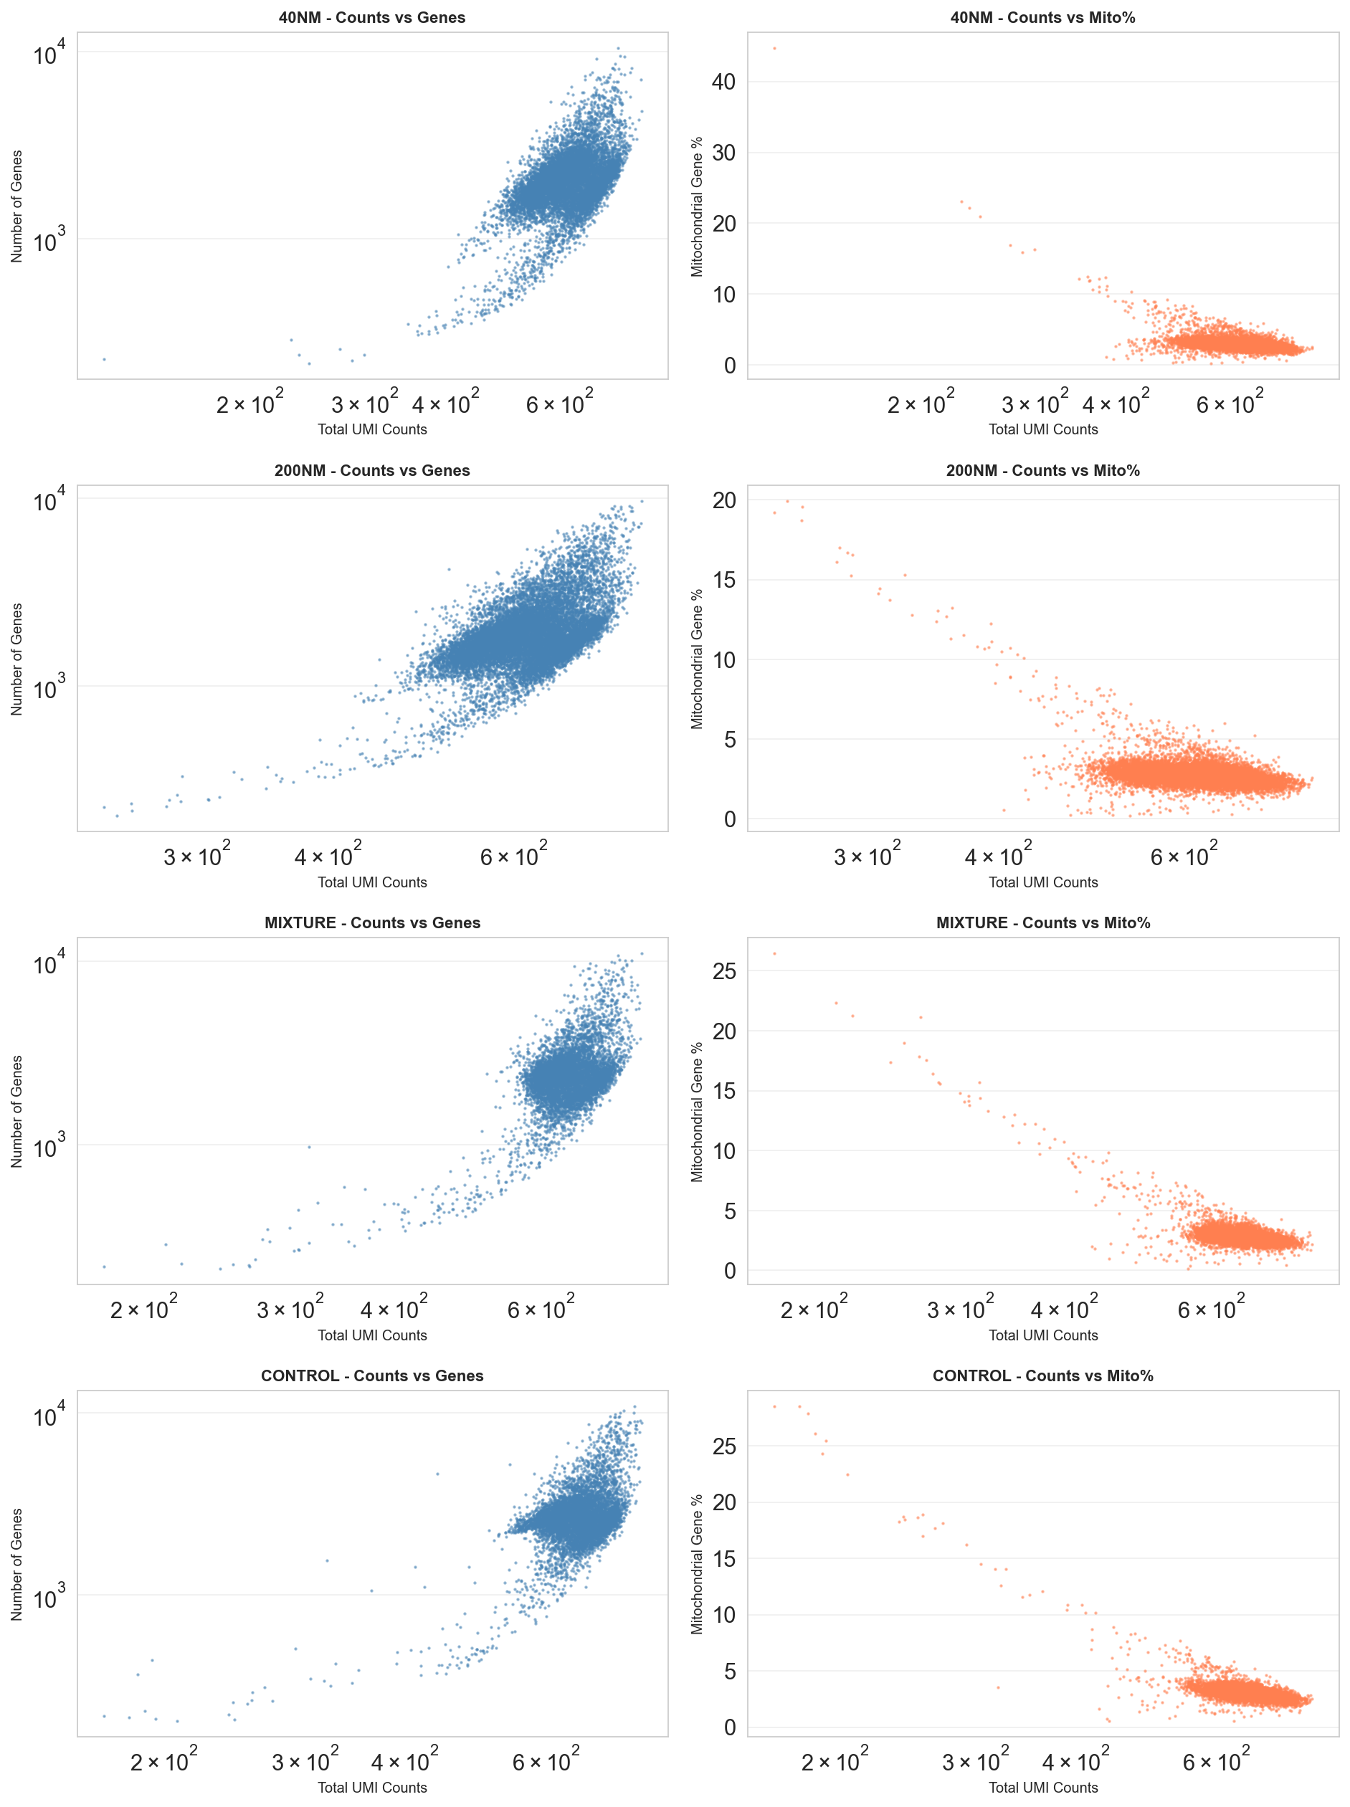
QC & Preprocessing
Cell filtering criteria:
Minimum counts: 200
Minimum genes: 200
Maximum genes: 5000
Maximum mitochondrial: 10%
Gene filtering:
Minimum cells: 3

Slide 4
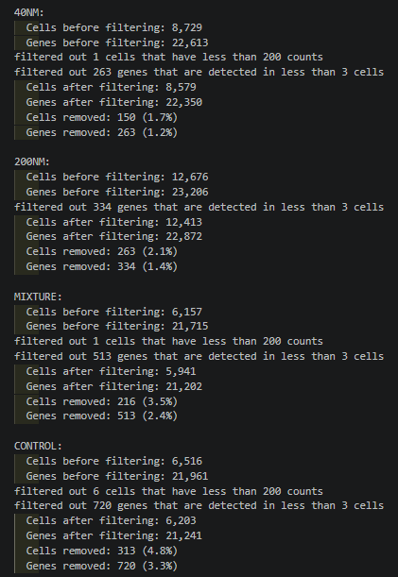
QC & Preprocessing
The minimum counts threshold was chosen based on the total UMI count graph, and not to be a strict filter based on the results received when trying with multiple filter thresholds. The minimum genes threshold was chosen in a similar manner.
The maximum genes threshold was chosen to remove many doublets and multiplets, but still not be too strict to later affect the results. A similar logic was used for the mitochondrial percentage.
The filters seem to mostly affect the control group, so the chosen values weren’t strict.

Slide 5
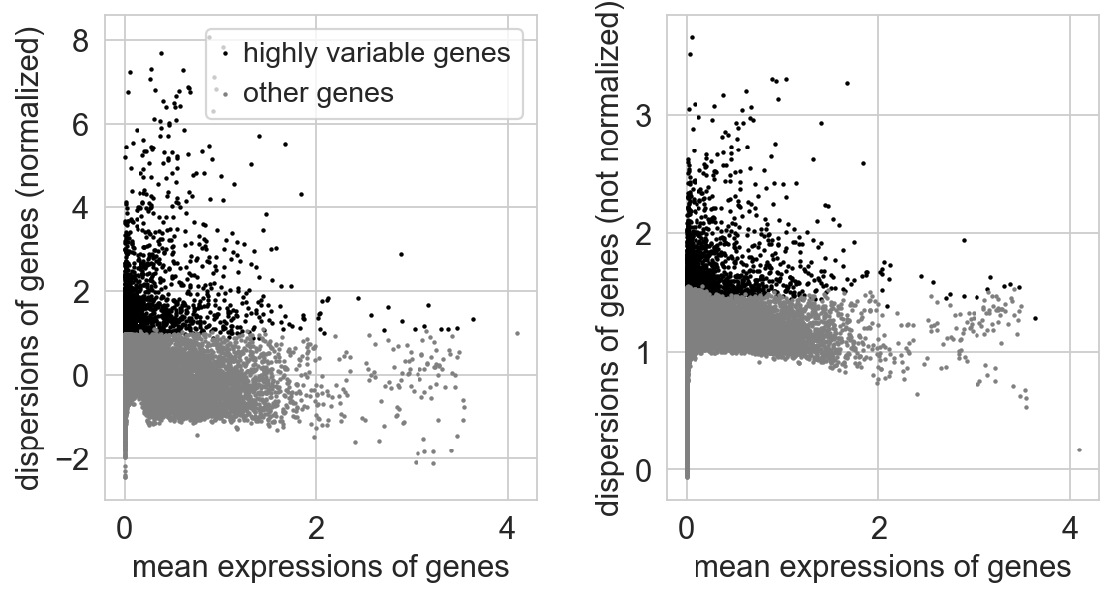
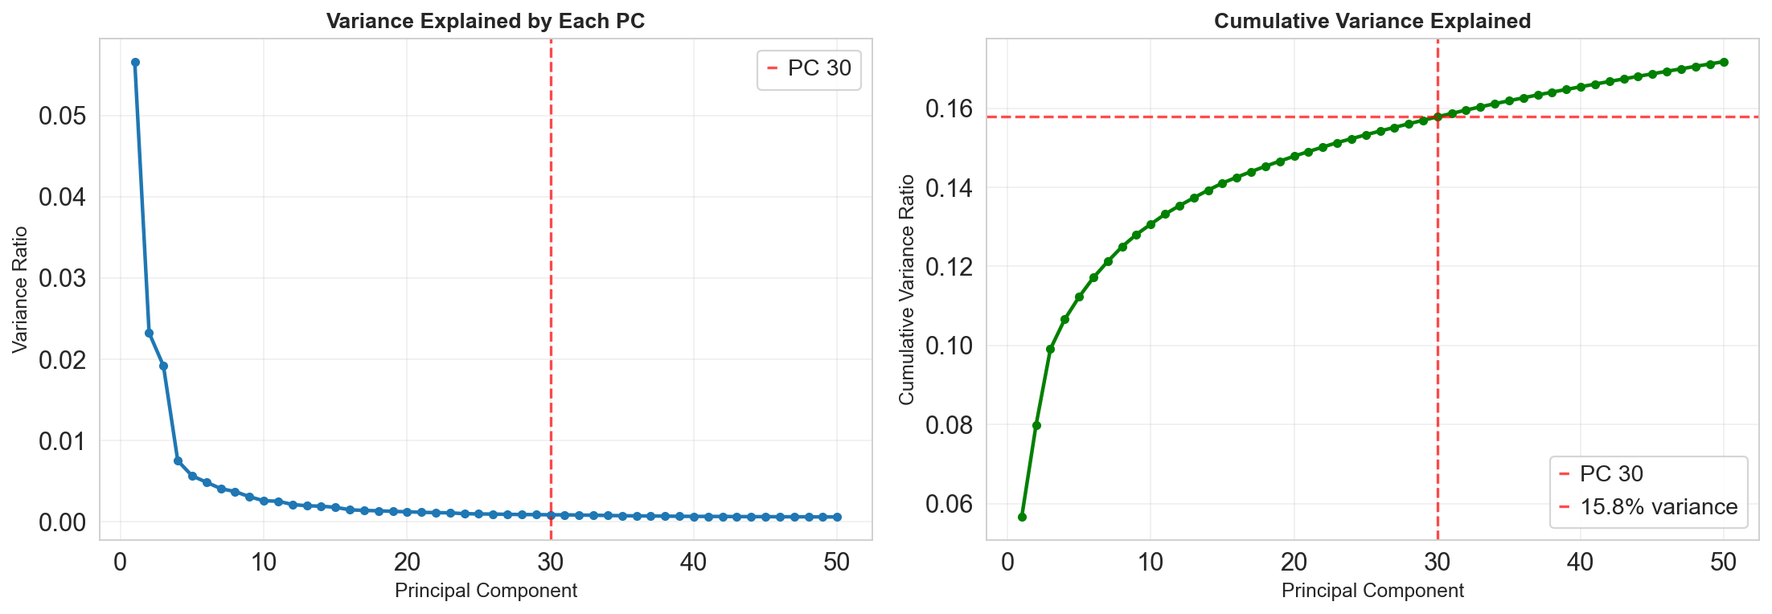
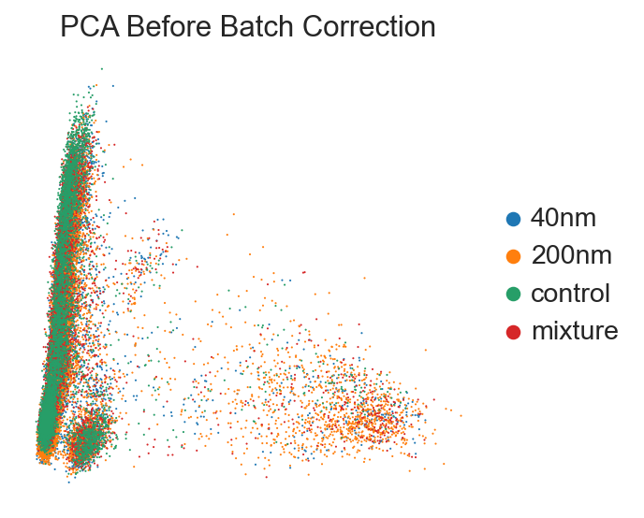
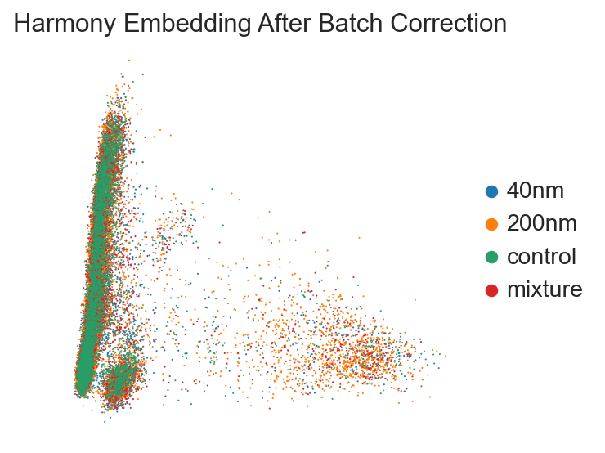
Integration & clustering

Slide 6
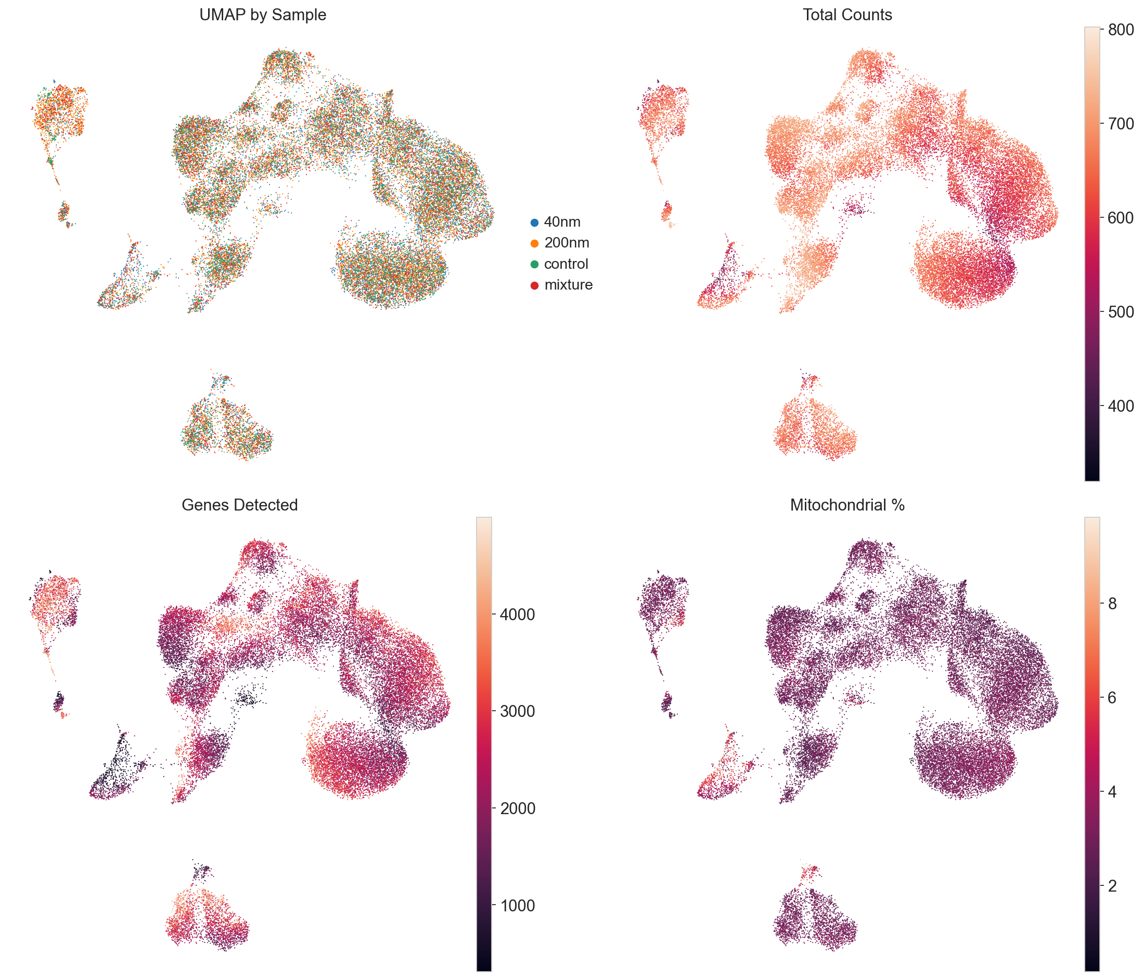
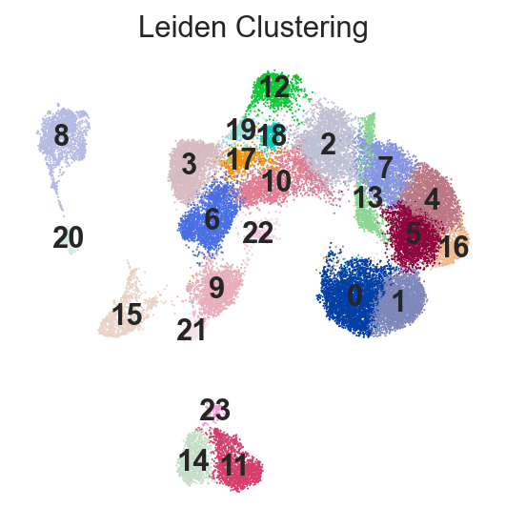
Integration & clustering

Slide 7
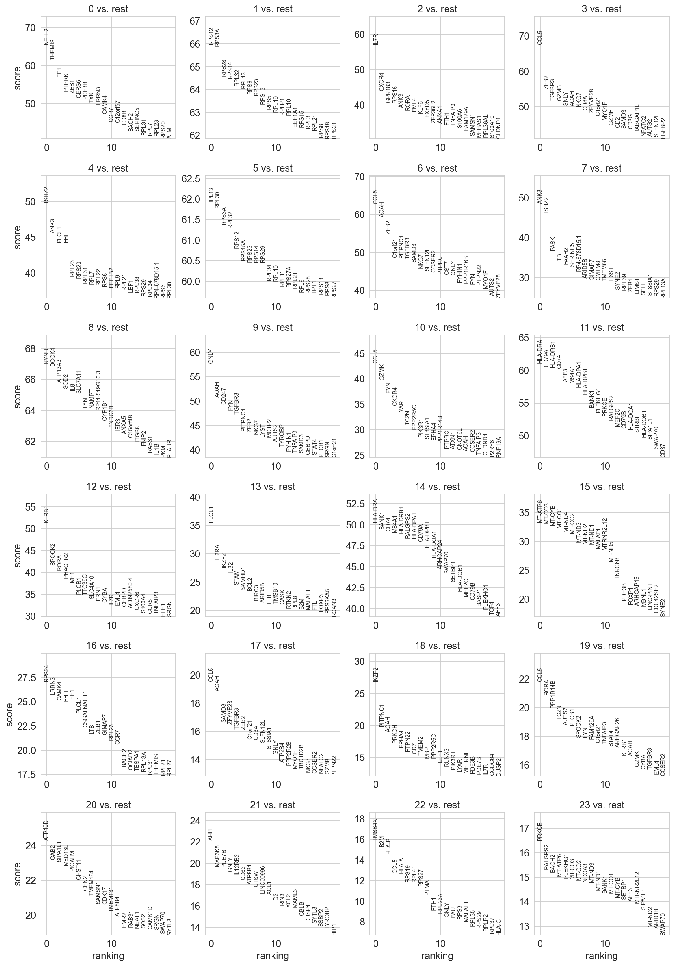
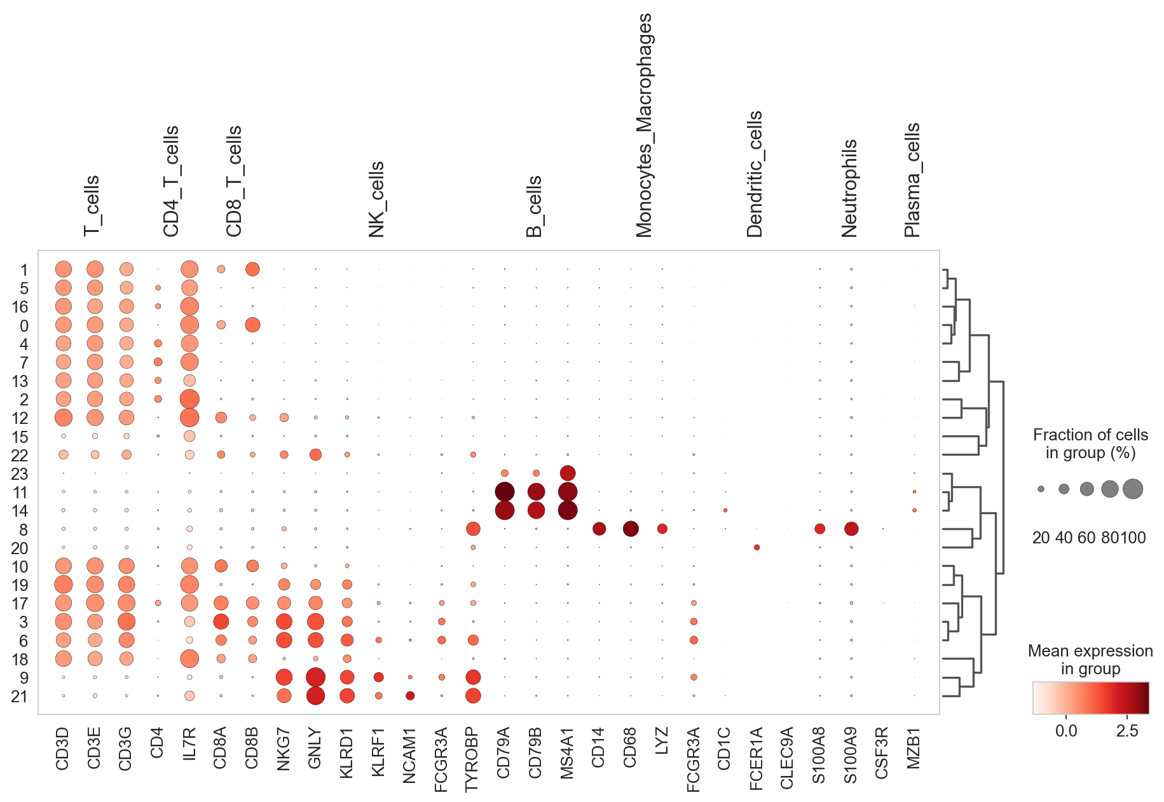
Cell type annotation
Common immune cell markers:
T cells: CD3D, CD3E, CD3G
B cells: CD79A, CD79B, MS4A1 (CD20)
NK cells: NKG7, GNLY, KLRD1
Monocytes/Macrophages: CD14, CD68, LYZ, FCGR3A (CD16)
Dendritic cells: CD1C, FCER1A, CLEC9A
Neutrophils: S100A8, S100A9, CSF3R
Plasma cells: IGHA1, IGHG1, MZB1

Slide 8
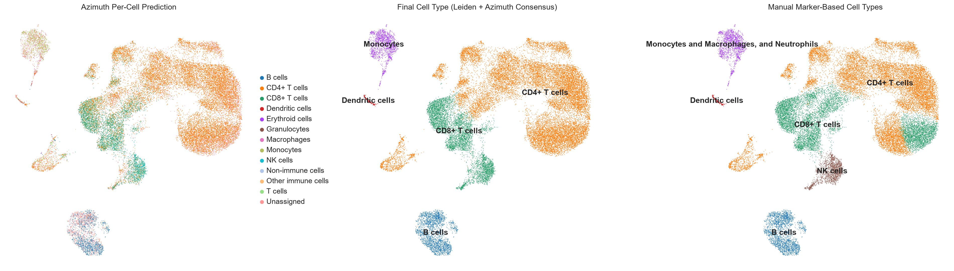
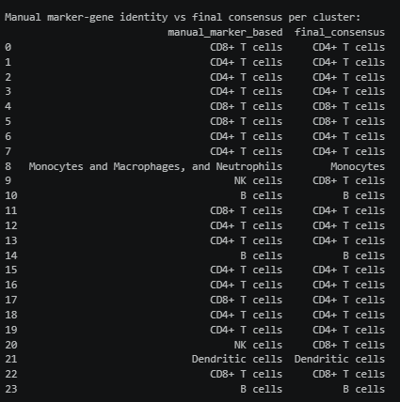
Cell type annotation

Slide 9
Cell type annotation
Manual marker-based identification seemed to distinguish NK cells, while resulting in similar values for other cell types as the Azimuth prediction. For this reason the manual identification was used for the rest of the analysis.

Slide 10
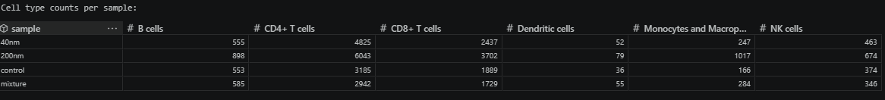
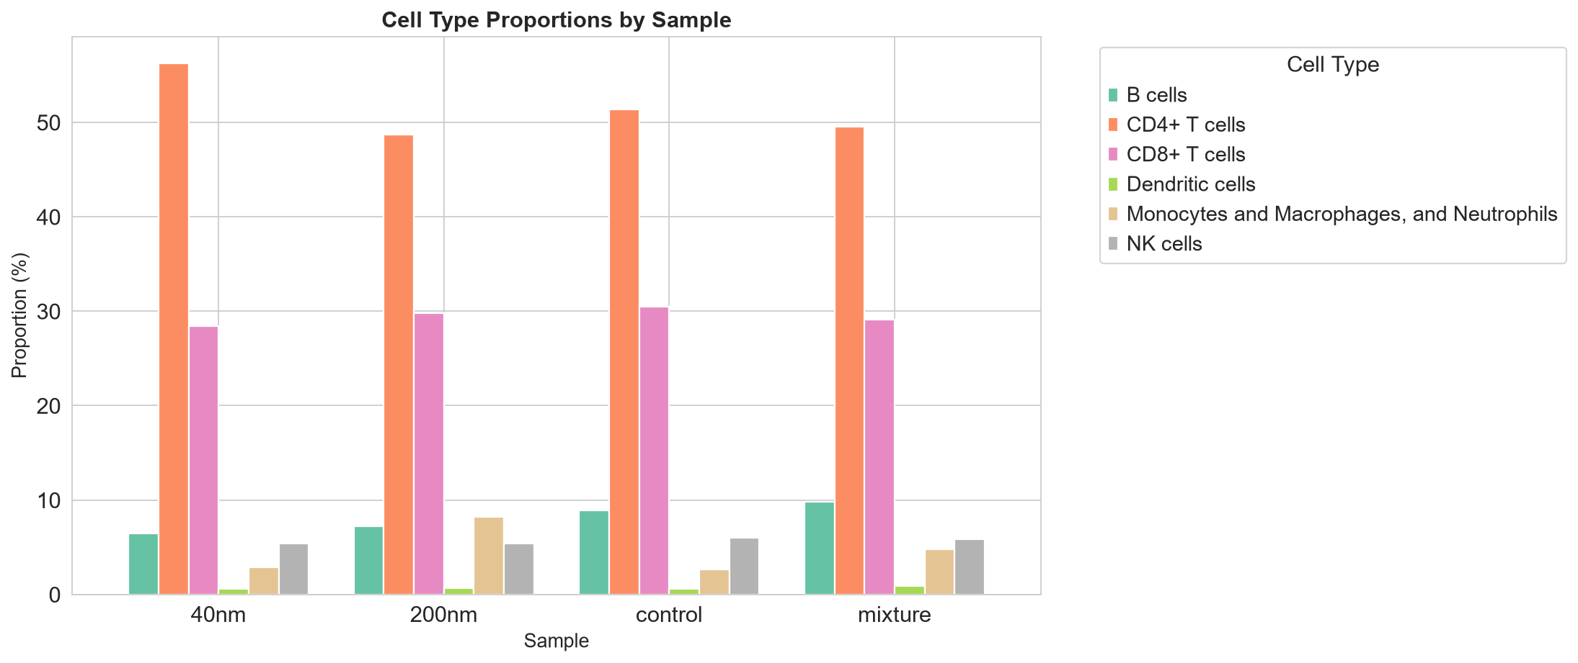
Composition Analysis

Slide 11
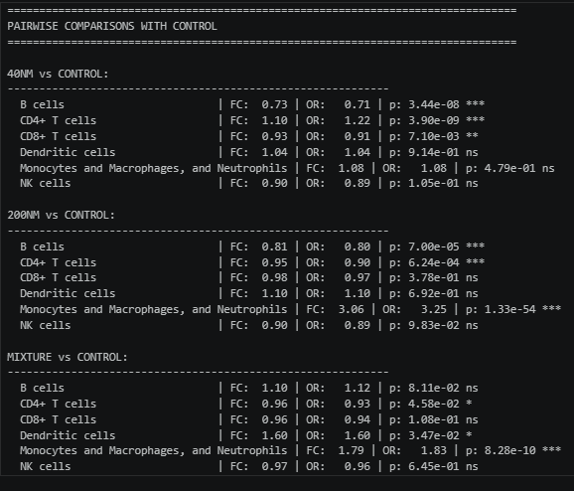
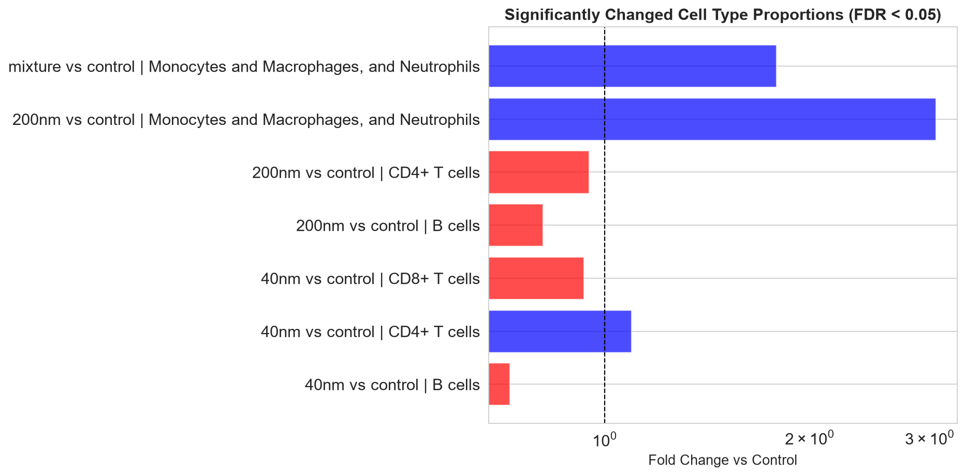
Composition Analysis

Slide 12
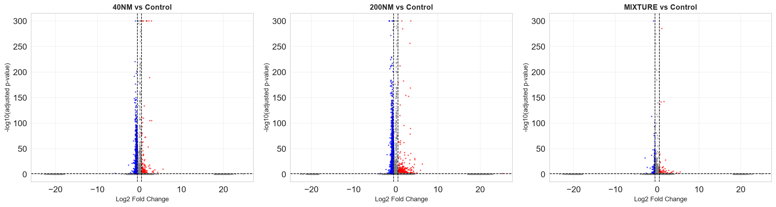
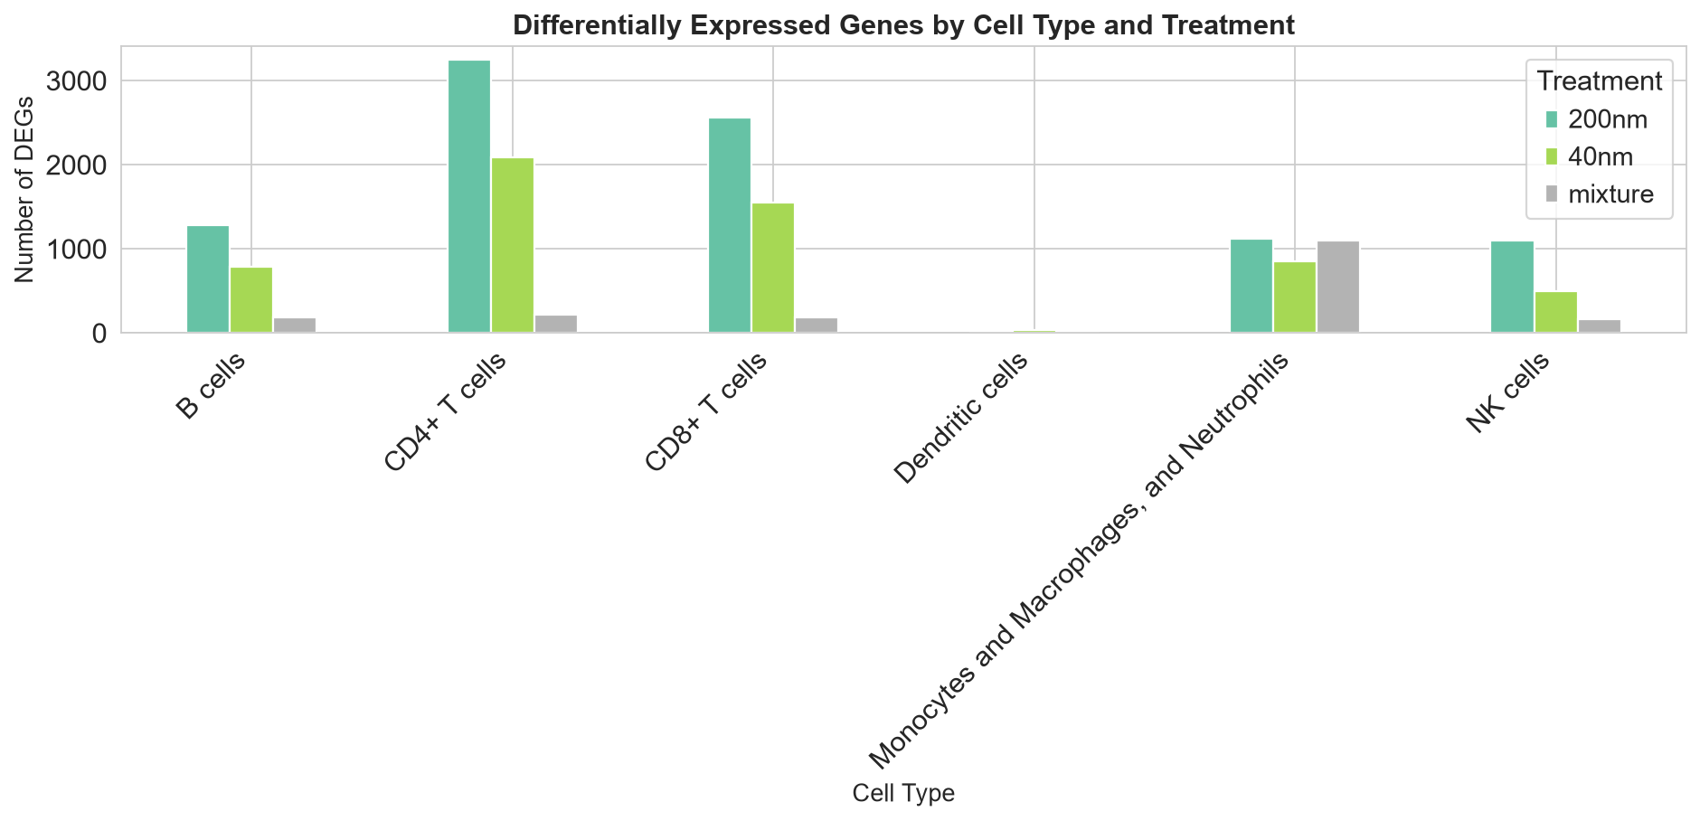
Differential Expression

Slide 13
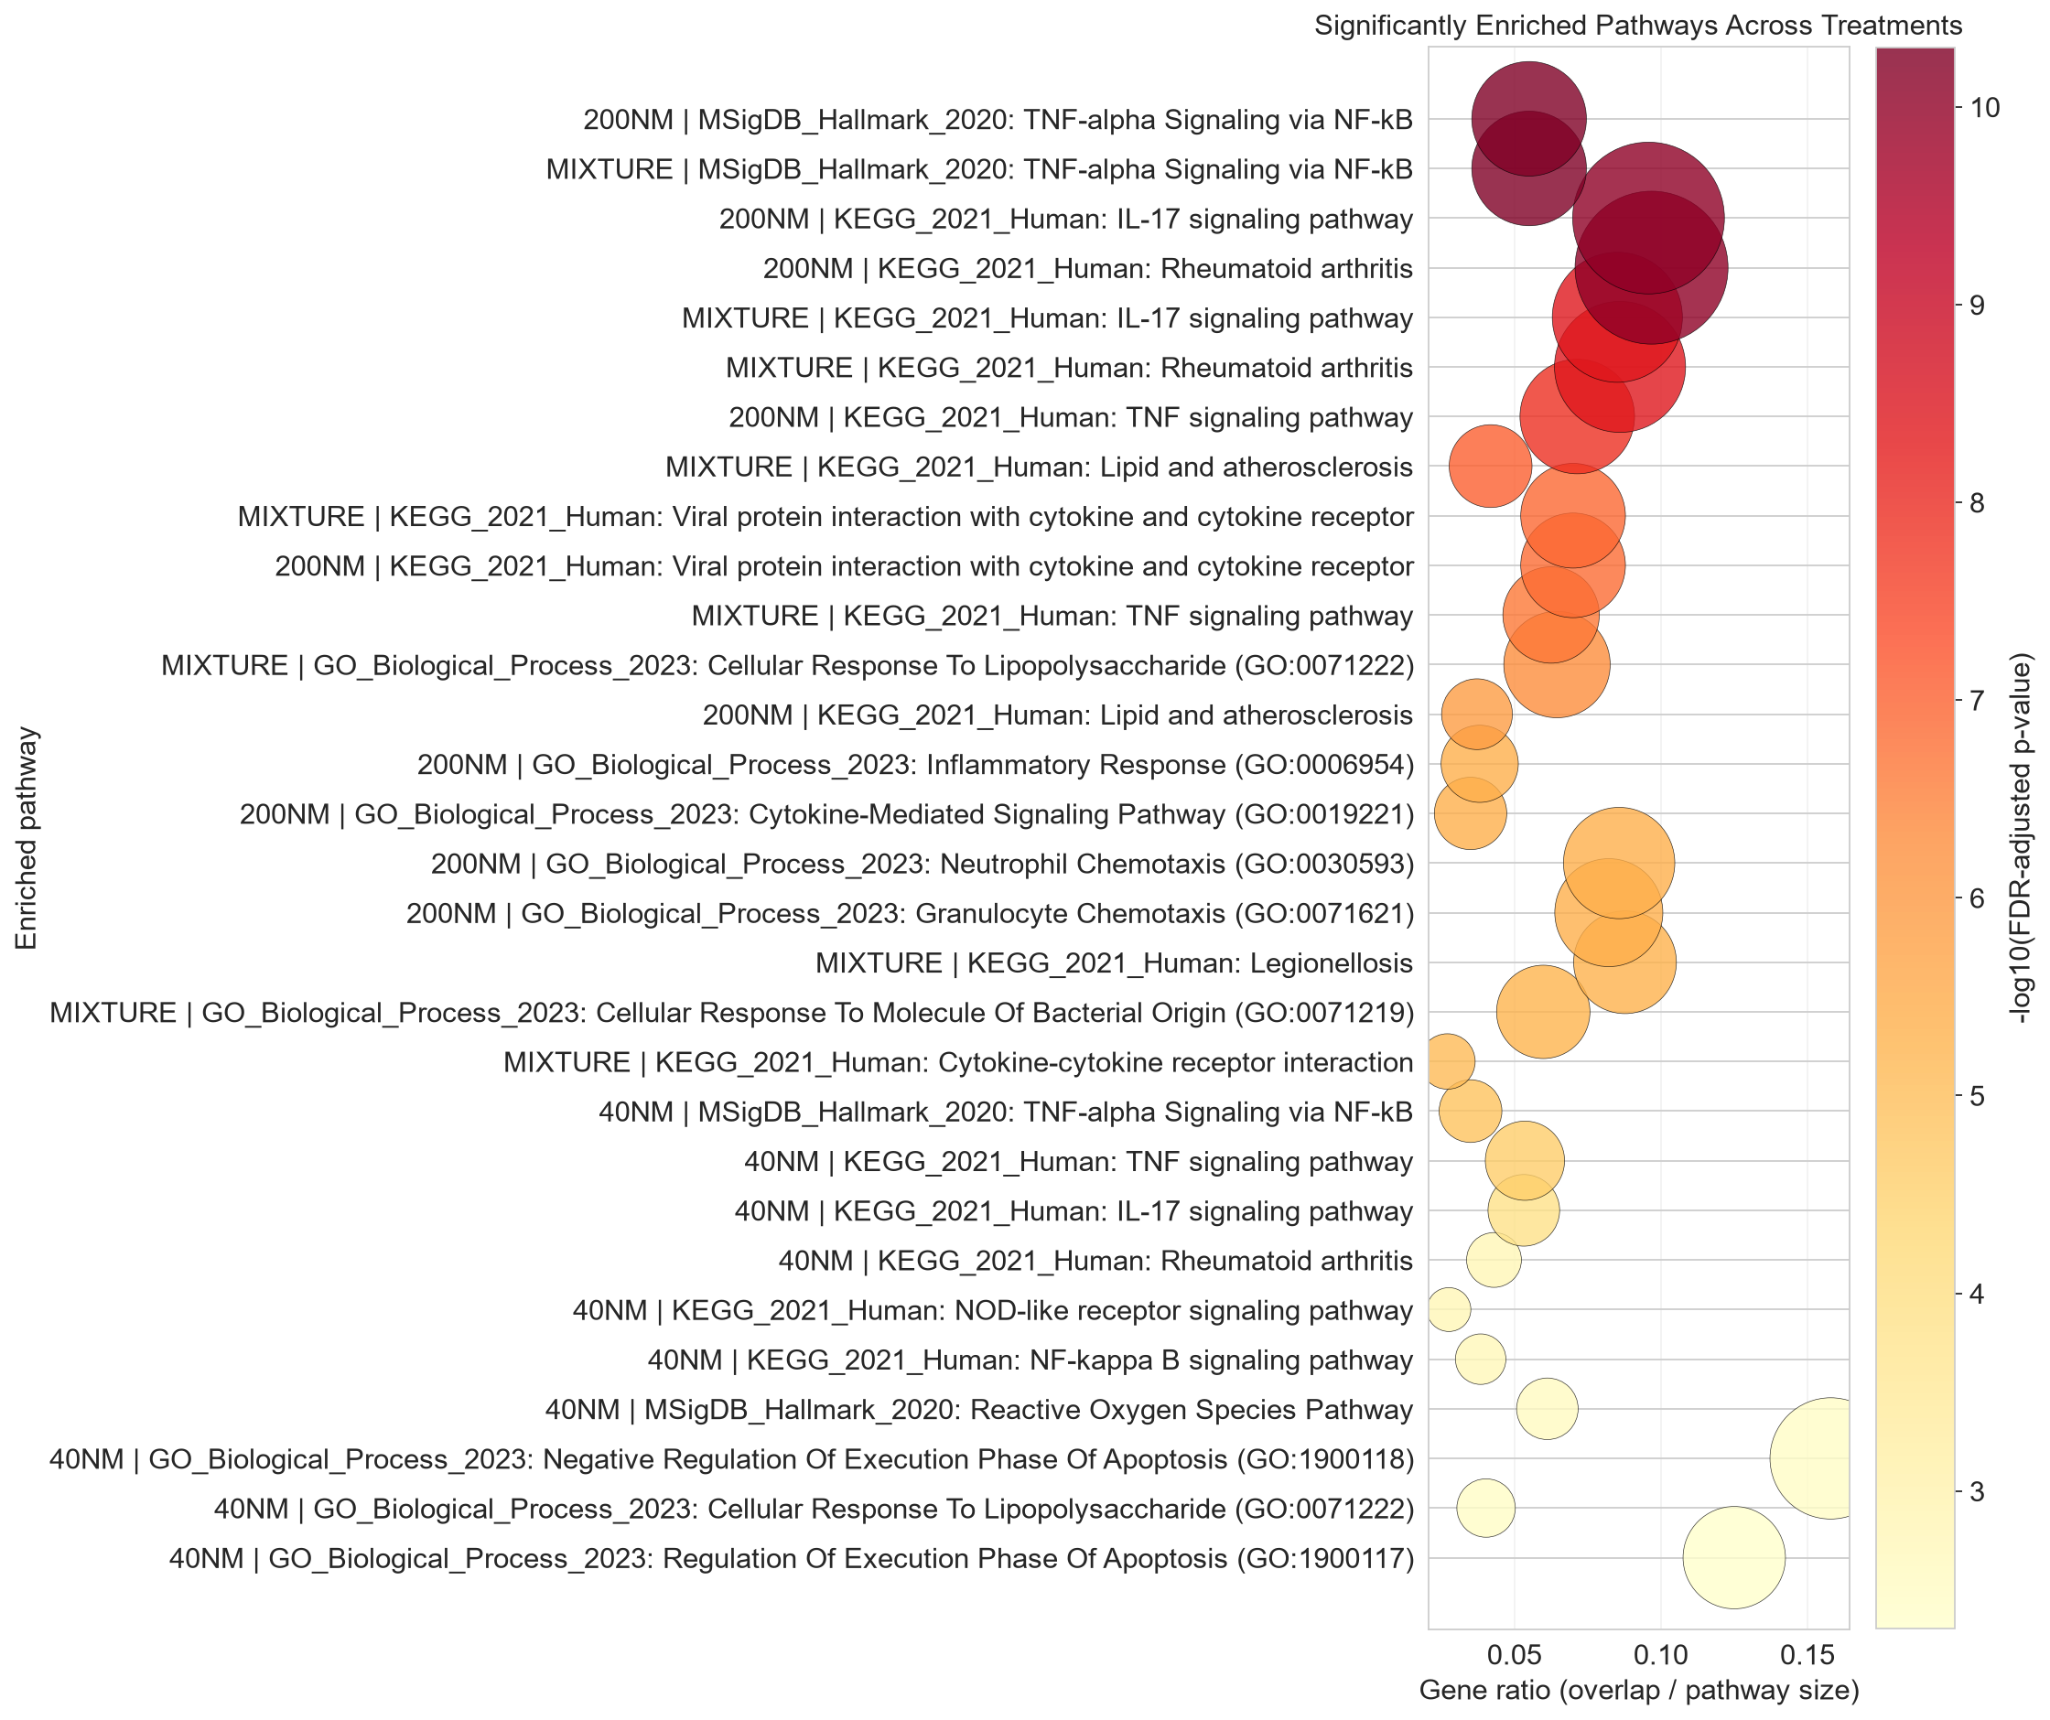
Differential Expression

Slide 14
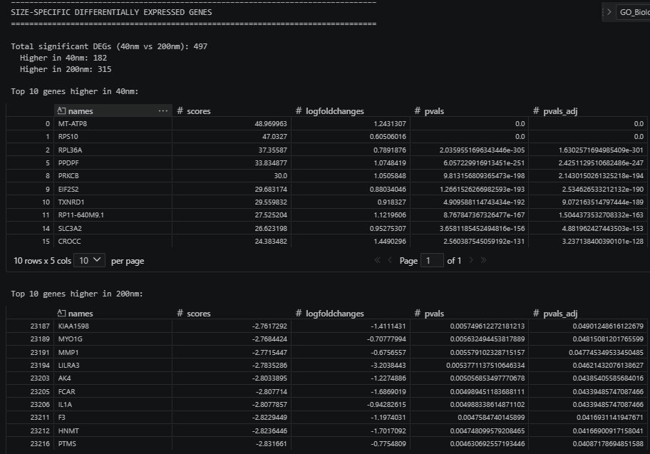
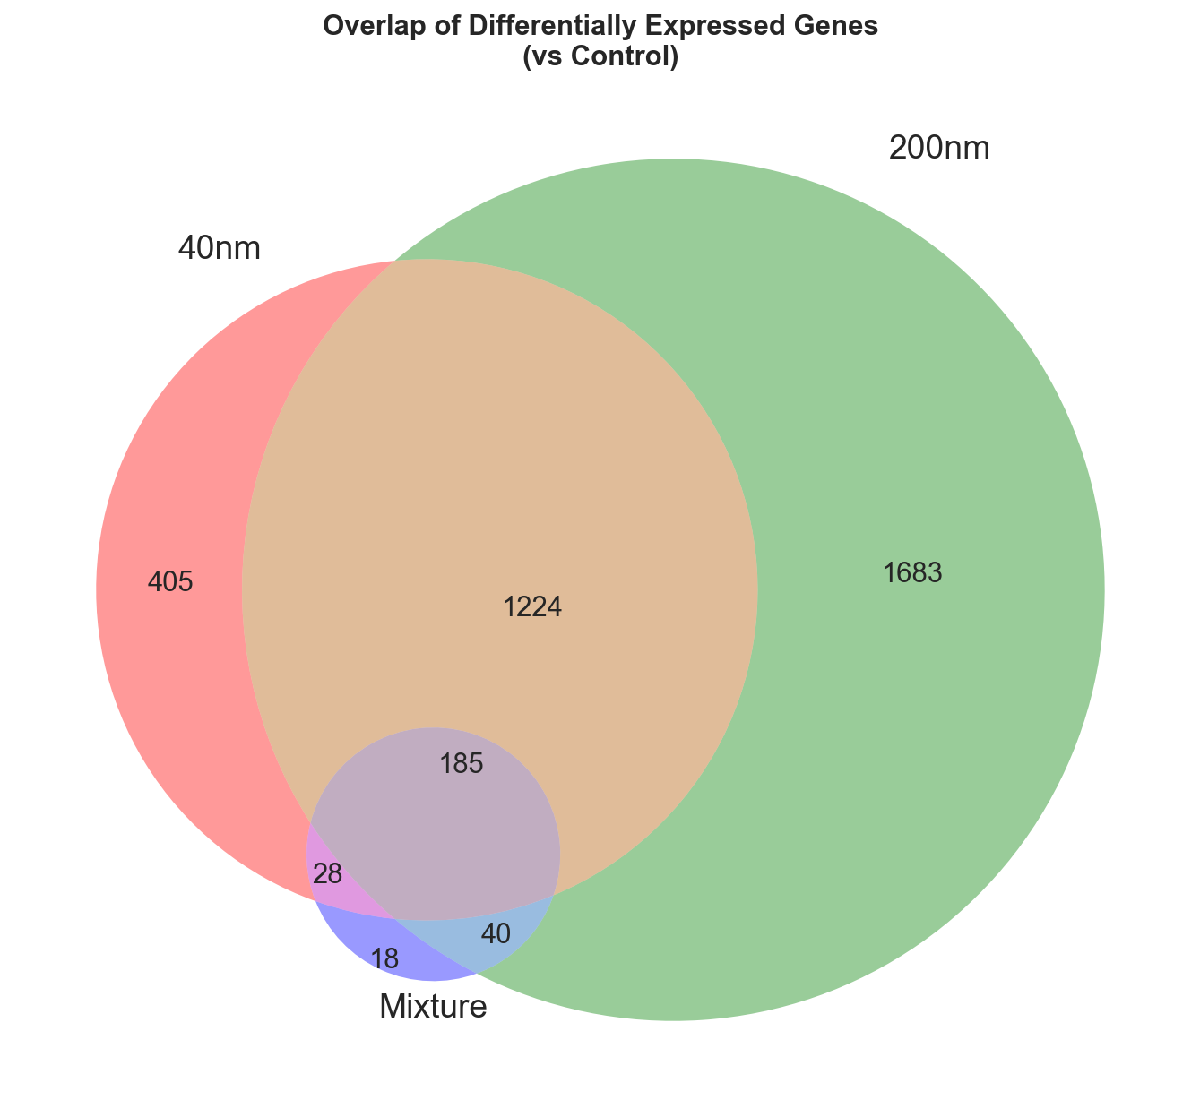
Size-Specific Effects

Slide 15
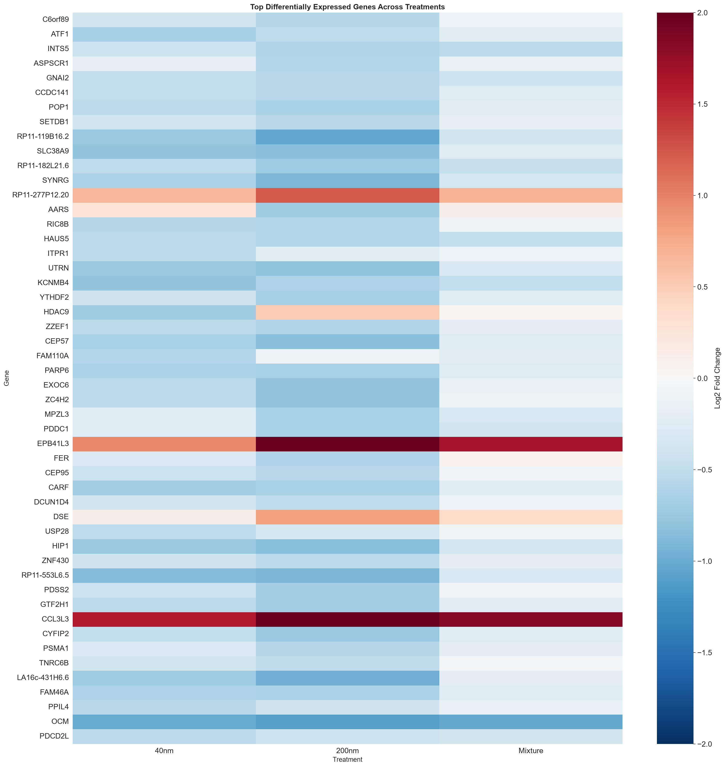
Size-Specific Effects
Both conditions produce strong responses, but the 200 nm exposure generates the largest overall change. The 40 nm shows a more selective pattern. This suggests that particle size influences how immune cells process the material and which pathways are activated. It is also apparent that while most DEGs are shared across both the 200 nm and 40 nm samples, they also affect a lot of different DEGs. The mixture ends up lessening some effects of the individual samples but also ends up resulting in some unique DEGs.

Slide 16
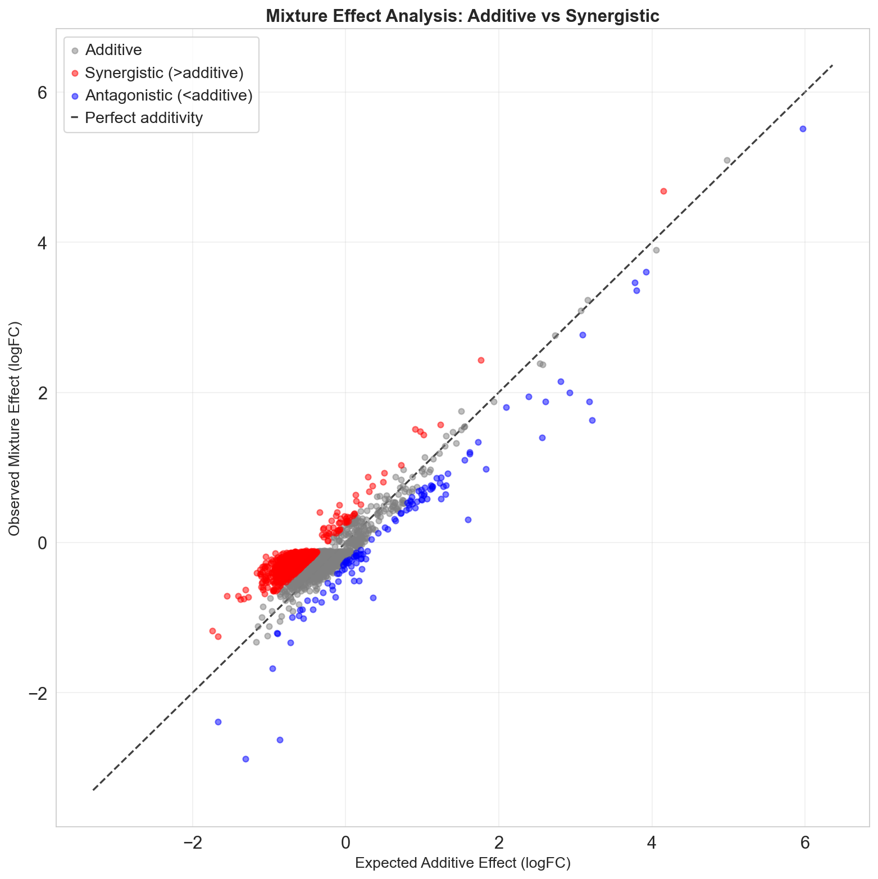
Size-Specific Effects
The mixture effect analysis shows that the combination of the 40 nm and 200 nm particles has a more complex effect than just adding the effects of them both. It results in a more complex immune response, and alters levels in a non-linear way.

Slide 17
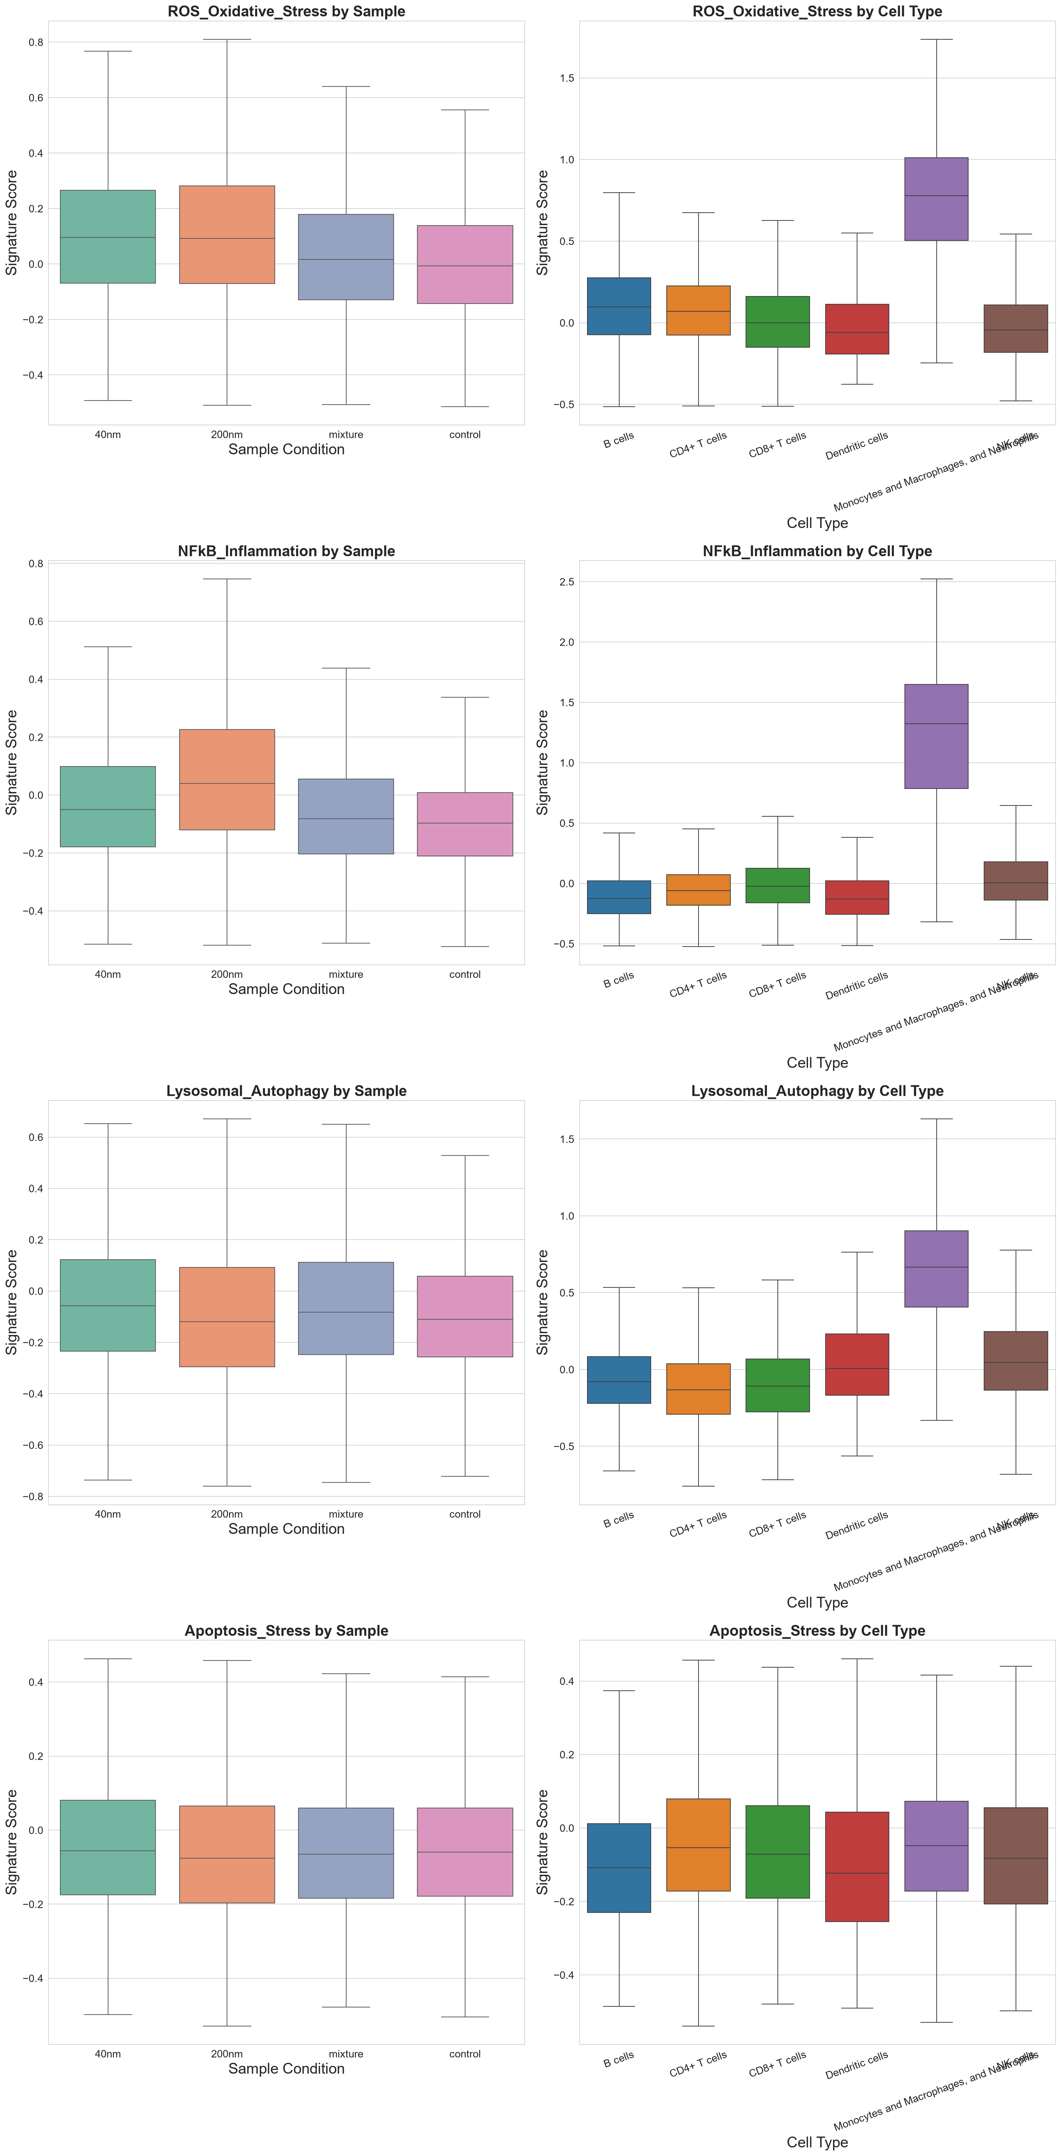
Size-Specific Effects
As the monocyte and macrophage group affects the ROS stress and inflammation the most, and the 200 nm group has a significant effect on its number, a raise in both is apparent in the 200 nm sample. The 40 nm samples also shows an effect on both values, while the mixture interestingly shows a lesser effect than both.
A significant effect on stress and inflammation is expected, since we are analyzing immune cells which are highly sensitive to inflammatory activation and stress.

Slide 18
Size-Specific Effects
Lysosomal autophagy and apoptosis stress scores are less affected, but show a higher effect in the 40 nm sample, and the mixture itself.
This increase is also expected due to the immune cells sensitivity to inflammatory activation and stress.

